Slide 1
How can small independent pharmacies compete with the big chains?
Group member: Yue Yu, Ruokai Zhao, Yan Tan, Yuan Yao

Slide 2
Agenda
Executive Summary
Problem statement
Data modeling
Data analysis
Recommendations

Slide 3
Executive Summary
Problem statement:
Recommend actions that Independent Pharmacy owner can take to increase their revenue from the
front-end of store.
1
Approaches:
Built a data model and utilized MySQL/Access to analyze the data.
2
Recommendations :
Products and categories optimization; Inventory management; Geographic and economic
recommendations.
3
Executive Summary
Problem Statement
Data Modeling
Data Analysis
Recommendations

Slide 4
Problem statement
Background:
Independent pharmacies typically generate the majority of the business’ revenue from prescriptions filled by the pharmacy.
They are often competing with mass merchants, grocery stores, and chain drugstores who can offer a broader selection of over-the-counter (OTC) products.
Challenge:
Recommend actions that Independent Pharmacy owner can take to increase their revenue from the front-end of store.
Executive Summary
Problem Statement
Data Modeling
Data Analysis
Recommendations

Slide 5
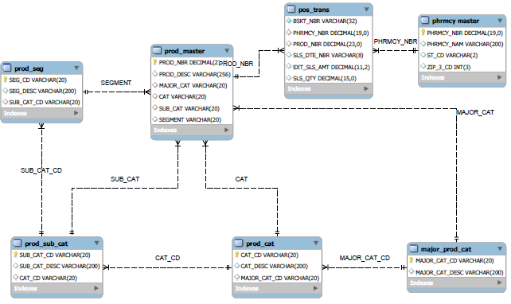
Data Modeling
Executive Summary
Problem Statement
Data Modeling
Data Analysis
Recommendations

Slide 6
Data Analysis – 80% sales come from 3000 products, 1219 products generate sales > $1000 during 2016.1-6
98,377 products in total;
Top sales products:
Top 3000 products generated 80% sales;
1219 products generate sales > $1000 during the period 2016.1-2016.6
Bottom sales products:
77,631 products didn't generate sales during the period 2016.1-2016.6
We only analyze the sample of 1219 products, which is identified as "more effective products".
Executive Summary
Problem Statement
Data Modeling
Data Analysis
Recommendations

Slide 7
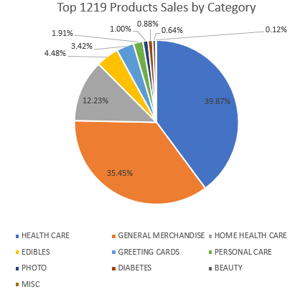
Data Analysis – Top3 Major categories generated 87.54% of the sales within 1219 products
Top3 Major categories generated 87.54% of the sales.
Health Care/General Merchandise/Home Health Care
There are 3 Major categories generated 1.64% of sales in total.
Diabetes/Beauty/MISC
Executive Summary
Problem Statement
Data Modeling
Data Analysis
Recommendations

Slide 8
Data Analysis - Products always in stock & shouldn't be carried
Products always in stock
We identify the product list as the top 3 major categories in 1219 products.
There are 1036 products should always in stock among the 1219 products.
Products & categories shouldn't be carried
Products: 77,631 products (those didn't generate sales)
Categories: Diabetes/Beauty/MISC (those only generated 1.64% of the sales)
Executive Summary
Problem Statement
Data Modeling
Data Analysis
Recommendations

Slide 9
Data Analysis – 64 out of 106 pharmacies(revenue generator) didn’t carry the top5 categories
Only 106 out of 1097 pharmacies generated revenue during the period 2016.1-6.
Top5 categories generated 52% of the sales.
Misc Genral Merchandise/Cold & Allergy/Vitamins/Dietary Supplements/Home health Care/Greeting Cards&Other Associated Items
There are 64 Pharmacies that generated revenue didn’t sell all these categories
Executive Summary
Problem Statement
Data Modeling
Data Analysis
Recommendations
Notes:
Only 106 pharmacy has sales value.(in the given 1097 list)

Slide 10
Data Analysis - We analyzed the data from geographic and economic perspective...
PA, NJ and CT occupy most parts of the sales in Pharmacy.
Sales make up
Pharmacies in CT has a relatively higher average sales per Pharmacy.
Pharmacies in DE and NY has much lower average sales.
pharmacy sales in states
Executive Summary
Problem Statement
Data Modeling
Data Analysis
Recommendations

Slide 11
Data Analysis - We compared two locations’ customer purchasing tendency
ST_CD |  | PROD_DESC | Unit_Price | quantity | Average price
DE |  | BABY SHAMPOO MY FAIR BABY 12X12OZ PUC | 1 | 3 | 23.758
DE |  | ORAL B TOOTHBRUSH PRO HEALTH KIDS MED | 5.19 | 2
DE |  | LUCKY SOAP DEODORANT BAR 12X2PK PUC | 1 | 2
DE |  | RELIEF 20-30 KH CT W/SIL XLF | 75 | 1
DE |  | CONV 403326 DUO DERM DRS 5 | 43.1 | 1
DE |  | ABDOMINAL BINDER SUPPORT LGE FUTURO | 33.99 | 1
DE |  | MUELLER ABDOMEN SUPPORT SM/MED | 23.99 | 1
DE |  | WRIST BRACE SM/MD RIGHT | 19.63 | 1
DE |  | MUELLER ABDOMEN SUPPORT LG/XL | 19.19 | 1
DE |  | KNEE SUPPORT CLOSED 4533 MUELLER | 15.49 | 1
People in DE tend to buy more expensive products in pharmacies. Since the average price of the top selling items in DE is 8 dollars higher than in CT.
ST_CD |  | PROD_DESC | Unit_Price | quantity | Average price
CT |  | ABD PAD STERILE 5"X9" 25CT | 0.3596 | 25 | 15.47992
CT |  | GAUZE 6 PLY ST 4X4 SPG 2X25 | 0.4796 | 25
CT |  | HASK ARGAN OIL DEEP TREATMENT 12X1.75OZ | 2.39 | 6
CT |  | TYROS 1 INFANT FORMULA | 55.25 | 5
CT |  | GLOVE CURAD EXAM 3G VINYL PF LG 100CT | 5 | 5
CT |  | STAMPS | 0.5 | 5
CT |  | CANDY & BEVERAGE | 0.1 | 5
CT |  | DME OPEN DEPARTMENT | 69.84 | 4
CT |  | TRIAD HYDRO WND GEL PST 2.5 OZ | 13.99 | 4
CT |  | PURPOSE GENTLE CLEANSING WASH 6OZ | 6.89 | 4
Pharmacies in CT have the highest average unit price while those in DE have lower average unit price.
Executive Summary
Problem Statement
Data Modeling
Data Analysis
Recommendations

Slide 12
Data Analysis - Factors need to take into consideration
＊all the conclusions are based on the assumption that data points are reliable.
Geographic
Economic
We would like to recommend pharmacies in other states to add more categories which sell well in CT.
We recommend the owner to choose CT as the target location.
Pharmacies in DE should stock more items with high price tag.
Pharmacies in CT should stock more items with low price tag.
Executive Summary
Problem Statement
Data Modeling
Data Analysis
Recommendations

Slide 13
Recommendations
Products and categories optimization:
Discontinue the products that didn’t generate revenue.
Expand top5 categories to 64 pharmacies which generated revenue but didn’t carry the top5.
Inventory management:
1036 products should always be in stock. (>$1000 & Top3 major categories).
Geographic and economic recommendations:
Open new pharmacies in CT.
Pharmacies should have more high price products in DE and cheaper ones in CT.
Executive Summary
Problem Statement
Data Modeling
Data Analysis
Recommendations

Slide 14
Appendix

Slide 15
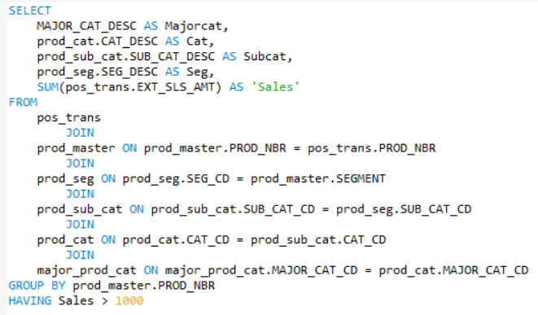
Products with sales greater than $1000

Slide 16
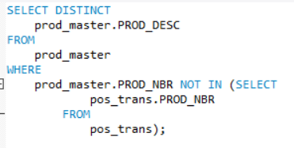
Products that do not have sales

Slide 17
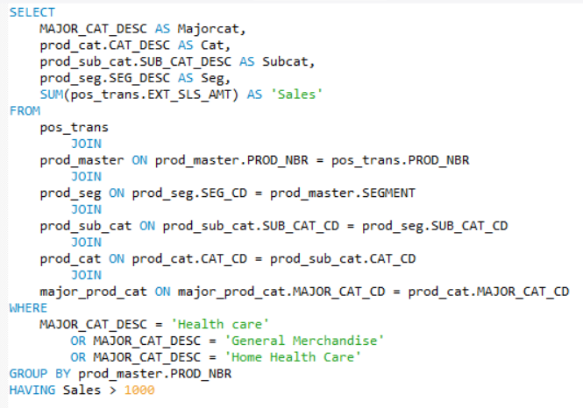
Products from top 3 major category

Slide 18
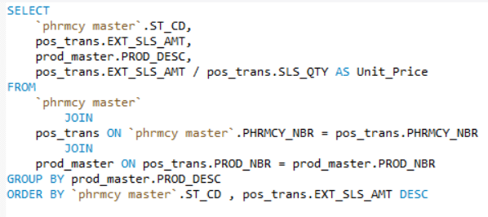
Top selling products in each state

Slide 19
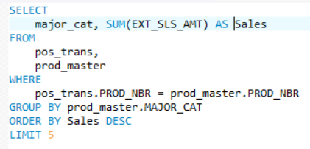
Sales for top 5 major category

Slide 20
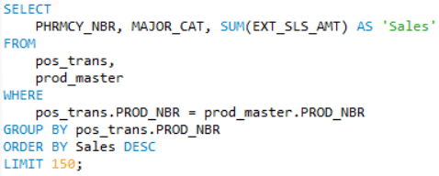
Major category in each pharmacy with sales

Slide 21
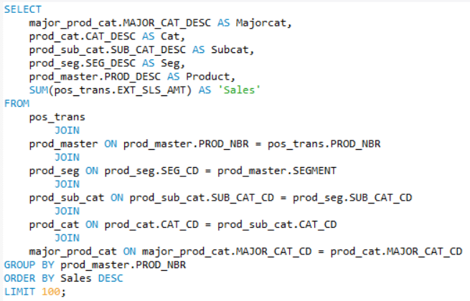
Top products by sales

Slide 22
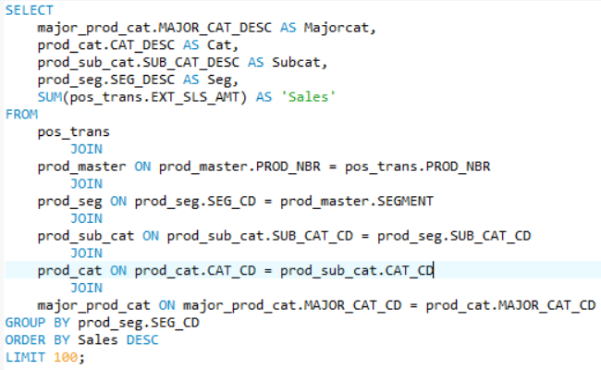
Top segments by sales

Slide 23
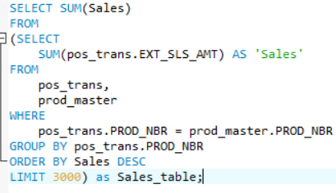
Total sales for top 3000 products

Slide 24
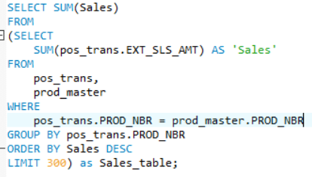
Total sales for top 300 products

Slide 25
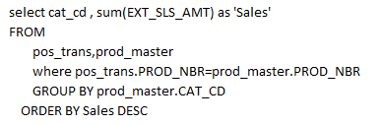
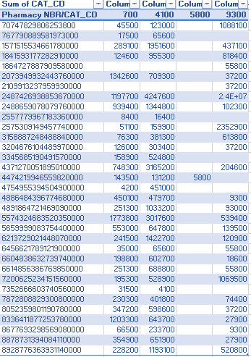
Product categories not being carried that should be?

Slide 26
Geographic and economic
Sql 1:
select st_cd, sum(sls_qty) as 'sales'from PHRMCY_MASTER, pos_transwhere PHRMCY_MASTER.PHRMCY_NBR=pos_trans.PHRMCY_NBRgroup by st_cdorder by sales DESC
ST_CD | sales | No of Phrmcy | Averge sales/no of Phrmcy | salesquantity | sales/salesquantity
NJ | 3366115.26 | 288 | 11687.90021 | 505533 | 6.658547038
PA | 2018783.09 | 196 | 10299.91372 | 272902 | 7.397465354
CT | 1416245.51 | 42 | 33720.13119 | 103364 | 13.70153545
NY | 1004424.93 | 390 | 2575.448538 | 97037 | 10.35094789
MA | 580191.82 | 51 | 11376.3102 | 99862 | 5.809935912
ME | 282871.94 | 21 | 13470.09238 | 52149 | 5.424302288
DE | 6306.13 | 4 | 1576.5325 | 1120 | 5.630473214
Sql 2:
SELECT ST_CD, sum(ext_sls_amt) as 'sales'FROM pos_trans, PHRMCY_MASTERwhere pos_trans.PHRMCY_NBR=PHRMCY_MASTER.PHRMCY_NBRgroup by ST_CDorder by sales desc;

Slide 27
Geographic and economic
SELECT `phrmcy master`.ST_CD, pos_trans.EXT_SLS_AMT, prod_master.PROD_DESCFROM `phrmcy master` JOIN pos_trans ON `phrmcy master`.PHRMCY_NBR = pos_trans.PHRMCY_NBR JOIN prod_master ON pos_trans.PROD_NBR = prod_master.PROD_NBRGROUP BY prod_master.PROD_DESCORDER BY `phrmcy master`.ST_CD , pos_trans.EXT_SLS_AMT DESC
ST_CD | EXT_SLS_AMT | PROD_DESC | Unit_Price | quantity | Average price
CT | 8.99 | ABD PAD STERILE 5"X9" 25CT | 0.3596 | 25 | 15.47992
CT | 11.99 | GAUZE 6 PLY ST 4X4 SPG 2X25 | 0.4796 | 25
CT | 14.34 | HASK ARGAN OIL DEEP TREATMENT 12X1.75OZ | 2.39 | 6
CT | 276.25 | TYROS 1 INFANT FORMULA | 55.25 | 5
CT | 25 | GLOVE CURAD EXAM 3G VINYL PF LG 100CT | 5 | 5
CT | 2.5 | STAMPS | 0.5 | 5
CT | 0.5 | CANDY & BEVERAGE | 0.1 | 5
CT | 279.36 | DME OPEN DEPARTMENT | 69.84 | 4
CT | 55.96 | TRIAD HYDRO WND GEL PST 2.5 OZ | 13.99 | 4
CT | 27.56 | PURPOSE GENTLE CLEANSING WASH 6OZ | 6.89 | 4
ST_CD | EXT_SLS_AMT | PROD_DESC | Unit_Price | quantity | Average price
DE | 3 | BABY SHAMPOO MY FAIR BABY 12X12OZ PUC | 1 | 3 | 23.758
DE | 10.38 | ORAL B TOOTHBRUSH PRO HEALTH KIDS MED | 5.19 | 2
DE | 2 | LUCKY SOAP DEODORANT BAR 12X2PK PUC | 1 | 2
DE | 75 | RELIEF 20-30 KH CT W/SIL XLF | 75 | 1
DE | 43.1 | CONV 403326 DUO DERM DRS 5 | 43.1 | 1
DE | 33.99 | ABDOMINAL BINDER SUPPORT LGE FUTURO | 33.99 | 1
DE | 23.99 | MUELLER ABDOMEN SUPPORT SM/MED | 23.99 | 1
DE | 19.63 | WRIST BRACE SM/MD RIGHT | 19.63 | 1
DE | 19.19 | MUELLER ABDOMEN SUPPORT LG/XL | 19.19 | 1
DE | 15.49 | KNEE SUPPORT CLOSED 4533 MUELLER | 15.49 | 1

